Slide 1

UNIT-3
Double Linked List and
Its operations

Slide 2
Outcome
Able to understand and implement double linked list representation, applications, advantages and operations.

Slide 3
Double Linked List
A double linked list is a two-way list in which all nodes will have two links. This helps in accessing both successor node and predecessor node from the given node position. It provides bi-directional traversing. Each node contains three fields:
Left link.
Data.
Right link.
The left link points to the predecessor node and the right link points to the successor node. The data field stores the required data.

Slide 4
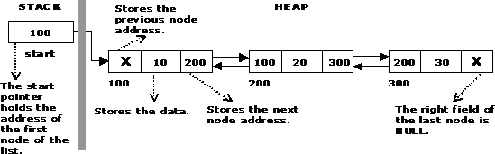
A Double Linked List

Slide 5
Basic operations in a double linked list
Creation
Insertion
Deletion
Traversing
The beginning of the double linked list is stored in a "start" pointer which points to the first node. The first node‘s left link and last node‘s right link is set to NULL.

Slide 6
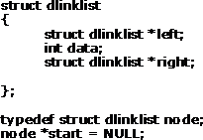

Structure of a Double Linked List

Slide 7
Creating a Double Linked List with N number of nodes
vo id c re at e list( int n)
{
int i;
no de * ne w no de; no de * t e m p;
fo r( i = 0 ; i < n; i+ +)
{
ne w no de = get no de(); if(st a rt = = NU LL)
{
sta rt = ne w no de;
}
e ls e
{
te m p = st a rt;
w hile(t e m p - > right)
te m p = t e m p - > right; te m p - > right = ne w no de;
ne w no de - > left = t e m p;
}
}
}

Slide 8

Creating a Double Linked List with N number of nodes

Slide 9
Inserting a node at the beginning
The following steps are to be followed to insert a new node at the beginning of the list:
Get the new node using getnode(). newnode=getnode();
If the list is empty then start = newnode.
If the list is not empty, follow the steps given below:
newnode -> right = start; start -> left = newnode; start = newnode;

Slide 10
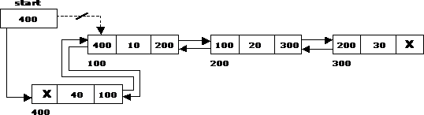
Inserting a node at the beginning

Slide 11
Inserting a node at the end
The following steps are followed to insert a new node at the end of the list:
Get the new node using getnode()
newnode=getnode();
If the list is empty then start = newnode.
If the list is not empty follow the steps given below: temp = start;
while(temp -> right != NULL) temp = temp -> right;
temp -> right = newnode; newnode -> left = temp;
120

Slide 12
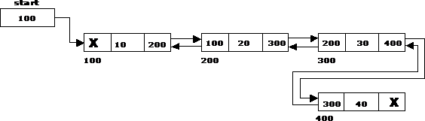
Inserting a node at the end
130

Slide 13
Inserting a node at an intermediate position
The following steps are followed, to insert a new node in an
intermediate position in the list:
Get the new node using getnode(). newnode=getnode();
Ensure that the specified position is in between first node and last node. If not, specified position is invalid. This is done by countnode() function.
Store the starting address (which is in start pointer) in temp and prev pointers. Then traverse the temp pointer upto the specified position followed by prev pointer.
After reaching the specified position, follow the steps given below: newnode -> left = temp;
newnode -> right = temp -> right; temp -> right -> left = newnode;
temp -> right = newnode;
•
•

Slide 14
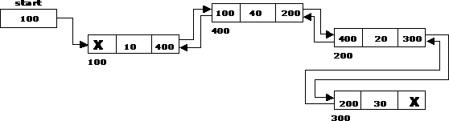
Inserting a node at an intermediate position

Slide 15
Deleting a node at the beginning
The following steps are followed, to delete a node at the beginning of the list:
If list is empty then display ‗Empty List‘ message.
If the list is not empty, follow the steps given below:
temp = start;
start = start -> right;
start -> left = NULL; free(temp);

Slide 16

Deleting a node at the beginning

Slide 17
Deleting a node at the end
The following steps are followed to delete a node at the end of the list:
If list is empty then display ‗Empty List‘ message
If the list is not empty, follow the steps given below:
temp = start;
while(temp -> right != NULL)
{
temp = temp -> right;
}
temp -> left -> right = NULL; free(temp);

Slide 18

Deleting a node at the end

Slide 19
Deleting a node at Intermediate
position
The following steps are followed, to delete a node from an intermediate position in the list.
If list is empty then display ‗Empty List‘ message.
If the list is not empty, follow the steps given below:
Get the position of the node to delete.
Ensure that the specified position is in between first node and last node. If not, specified position is invalid.
Then perform the following steps:
if(pos > 1 && pos < nodectr)
{
temp = start; i = 1;
while(i < pos)
{
temp = temp -> right; i++;
}
temp -> right -> left = temp -> left; temp -> left -> right = temp -> right; free(temp);
printf("\n node deleted..");
}

Slide 20
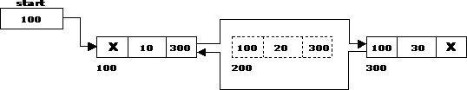
Deleting a node at Intermediate position

Slide 21
Traversal and displaying a list (Left to Right)
The following steps are followed, to traverse a list from left to right:
If list is empty then display ‗Empty List‘ message.
If the list is not empty, follow the steps given
below: temp = start;
while(temp != NULL)
{
print temp -> data; temp = temp -> right;
}
130

Slide 22
Traversal and displaying a list (Right to Left)
The following steps are followed, to traverse a list from right to left:
If list is empty then display ‗Empty List‘ message.
If the list is not empty, follow the steps given below: temp = start;
while(temp -> right != NULL) temp = temp -> right; while(temp != NULL)
{
print temp -> data; temp = temp -> left;
}
140

Slide 23
QUIZ
1. Which among the following segment of code deletes the element pointed to by X from the double linked list, if it is assumed that X points to the first element of the list and start pointer points to beginning of the list?
X -> bwd = X -> fwd; X -> fwd = X -> bwd
start = X -> fwd; start -> bwd = NULL;
start = X -> fwd; X -> fwd = NULL
X -> bwd -> bwd = X -> bwd; X -> fwd -> fwd = X -> fwd
2. Which among the following segment of code deletes the element pointed to by X from the double linked list, if it is assumed that X points to the last element of the list?
X -> fwd -> bwd = NULL;
X -> bwd -> fwd = X -> bwd;
X -> bwd -> fwd = NULL;
X -> fwd -> bwd = X -> bwd;

Slide 24
3. Which among the following segment of code counts the number of elements in the double linked list, if it is assumed that X points to the first element of the list and ctr is the variable which counts the number of elements in the list?
A. for (ctr=1; X != NULL; ctr++)X = X -> fwd;
for (ctr=1; X != NULL; ctr++) X = X -> bwd;
for (ctr=1; X -> fwd != NULL; ctr++) X = X -> fwd;
for (ctr=1; X -> bwd != NULL; ctr++) X = X -> bwd;
4. Which among the following segment of code counts the number of elements in the double linked list, if it is assumed that X points to the last element of the list and ctr is the variable which counts the number of elements in the list?
for (ctr=1; X != NULL; ctr++) X = X -> fwd;
for (ctr=1; X != NULL; ctr++) X = X -> bwd;
for (ctr=1; X -> fwd != NULL; ctr++) X = X -> fwd;
for (ctr=1; X -> bwd != NULL; ctr++) X = X -> bwd;

Slide 25
Tutorial Questions
Write an algorithm to insert an element anywhere in doubly linked list.
What are generalized lists? How are they different from Singly and Doubly linked lists?
Describe how a node can be deleted at a user specified position in a doubly linked list.

